Slide 1
Module 1: Networking Today
Introduction to Networks v7.0 (ITN)
Notes:
Cisco Networking Academy Program
Introduction to Networks v7.0 (ITN)
Module 1: Networking Today

Slide 2
1.3 Network Representations and Topologies
Notes:
1 – Networking Today
1.3 – Network Representations and Topologies

Slide 3
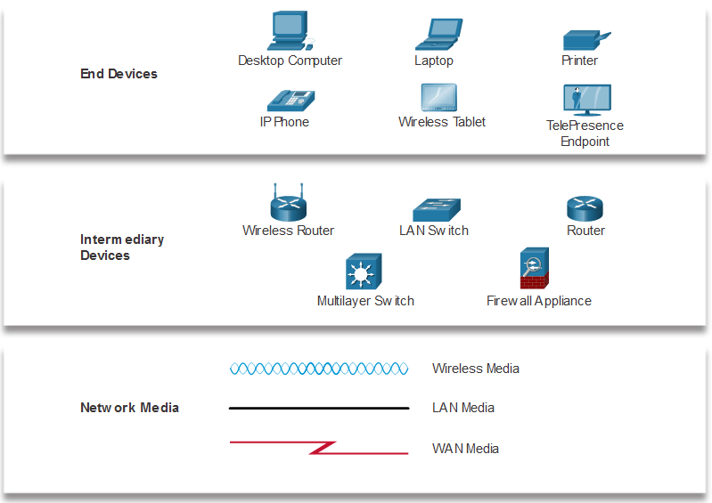
Network Representations and Topologies Network Representations
Network diagrams, often called topology diagrams, use symbols to represent devices within the network.
Important terms to know include:
Network Interface Card (NIC)
Physical Port
Interface
Note: Often, the terms port and interface are used interchangeably
Notes:
1 – Networking Today
1.3 – Network Representations and Topologies
1.3.1 – Network Representations

Slide 4
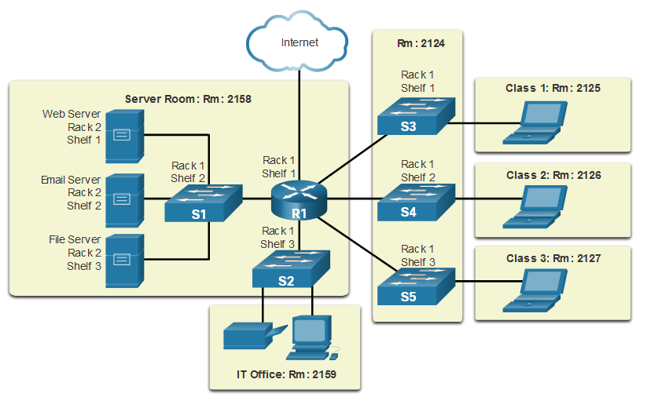
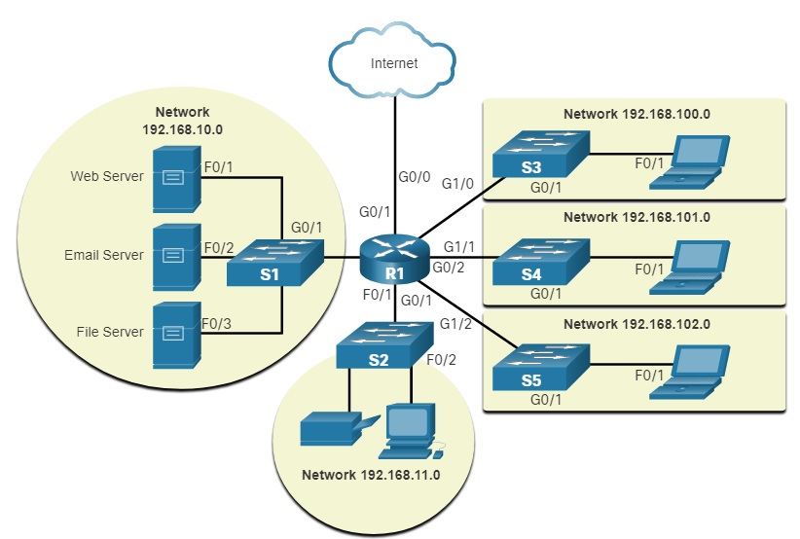
Network Representations and Topologies Topology Diagrams
Physical topology diagrams illustrate the physical location of intermediary devices and cable installation.
Logical topology diagrams illustrate devices, ports, and the addressing scheme of the network.
Notes:
1 – Networking Today
1.3 – Network Representations and Topologies
1.3.2 – Topology Diagrams
1.3.3 – Check Your Understanding – Network Representation and Topologies

Slide 5
1.4 Common Types of Networks
Notes:
1 – Networking Today
1.4 – Common Types of Networks

Slide 6
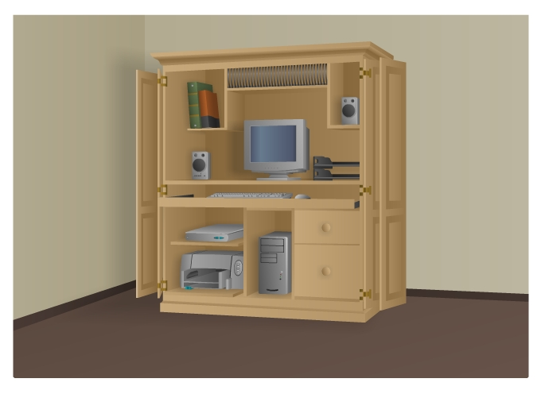

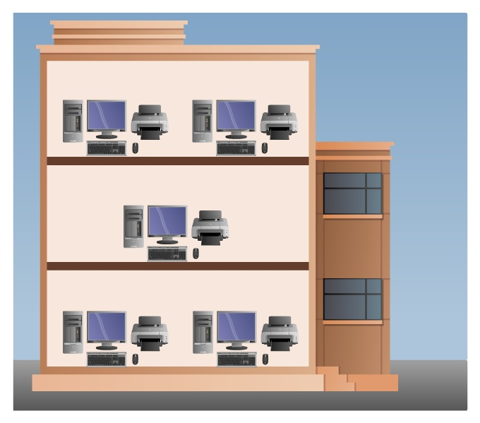
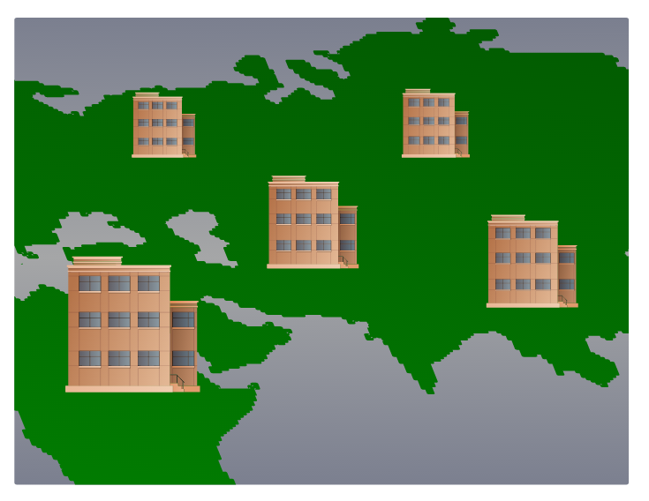
Common Types of Networks Networks of Many Sizes
Small Home Networks – connect a few computers to each other and the Internet
Small Office/Home Office – enables computer within a home or remote office to connect to a corporate network
Medium to Large Networks – many locations with hundreds or thousands of interconnected computers
World Wide Networks – connects hundreds of millions of computers world-wide – such as the internet
Small Home SOHO
Medium/Large World Wide
Notes:
1 – Networking Today
1.4 – Common Types of Networks
1.4.1 – Networks of Many Sizes

Slide 7
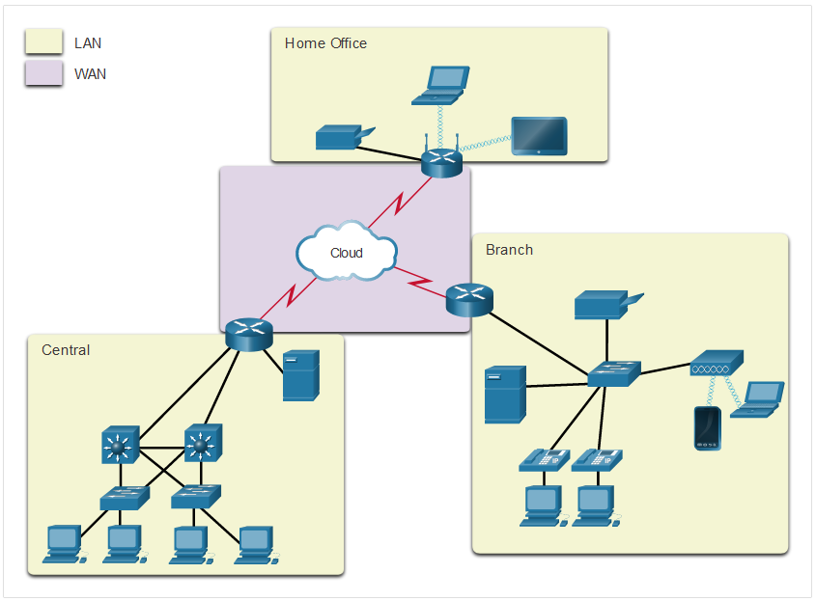
Common Types of Networks LANs and WANs
Network infrastructures vary greatly in terms of:
Size of the area covered
Number of users connected
Number and types of services available
Area of responsibility
Two most common types of networks:
Local Area Network (LAN)
Wide Area Network (WAN).
Notes:
1 – Networking Today
1.4 – Common Types of Networks
1.4.2 – LANs and WANs

Slide 8
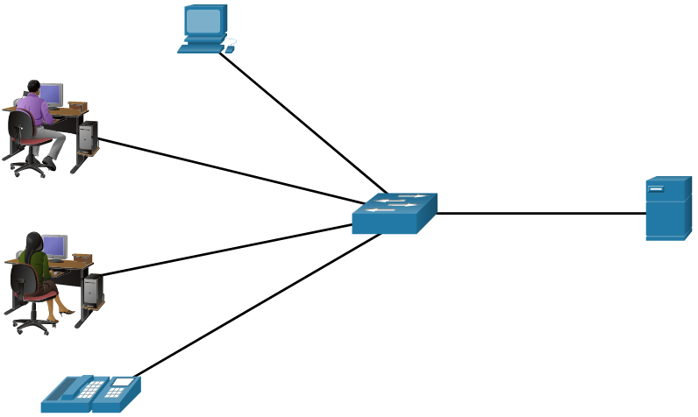
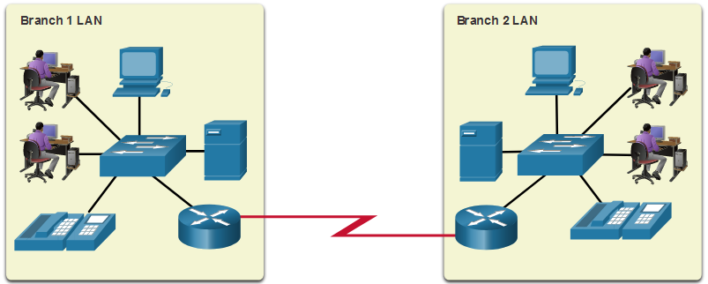
Common Types of Networks LANs and WANs (cont.)
A LAN is a network infrastructure that spans a small geographical area.
A WAN is a network infrastructure that spans a wide geographical area.
LAN | WAN
Interconnect end devices in a limited area. | Interconnect LANs over wide geographical areas.
Administered by a single organization or individual. | Typically administered by one or more service providers.
Provide high-speed bandwidth to internal devices. | Typically provide slower speed links between LANs.
Notes:
1 – Networking Today
1.4 – Common Types of Networks
1.4.2 – LANs and WANs (cont.)

Slide 9
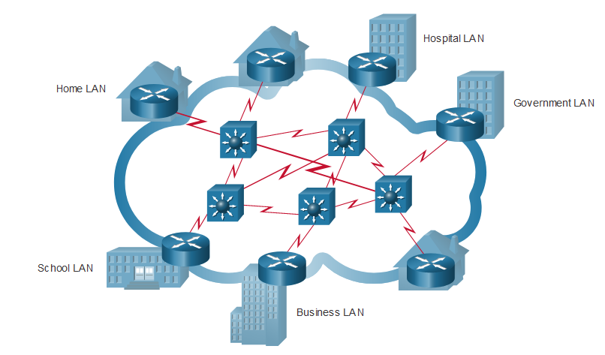
Common Types of Networks The Internet
The internet is a worldwide collection of interconnected LANs and WANs.
LANs are connected to each other using WANs.
WANs may use copper wires, fiber optic cables, and wireless transmissions.
The internet is not owned by any individual or group. The following groups were developed to help maintain structure on the internet:
IETF
ICANN
IAB
Notes:
1 – Networking Today
1.4 – Common Types of Networks
1.4.3 – The Internet

Slide 10
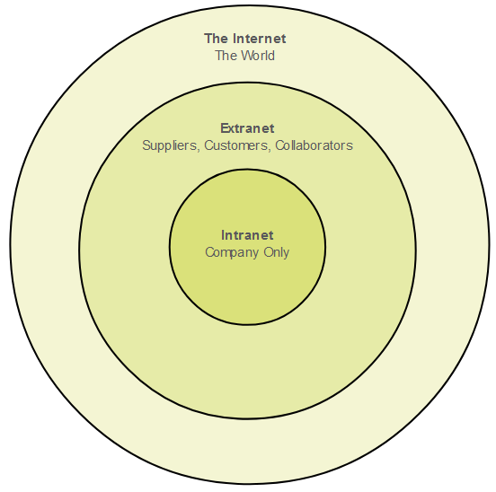
Common Types of Networks Intranets and Extranets
An intranet is a private collection of LANs and WANs internal to an organization that is meant to be accessible only to the organizations members or others with authorization.
An organization might use an extranet to provide secure access to their network for individuals who work for a different organization that need access to their data on their network.
Notes:
1 – Networking Today
1.4 – Common Types of Networks
1.4.4 – Intranets and Extranets
1.4.5 – Check Your Understanding – Common Types of Networks

Slide 11
1.5 Internet Connections
Notes:
1 – Networking Today
1.5 – Internet Connections

Slide 12
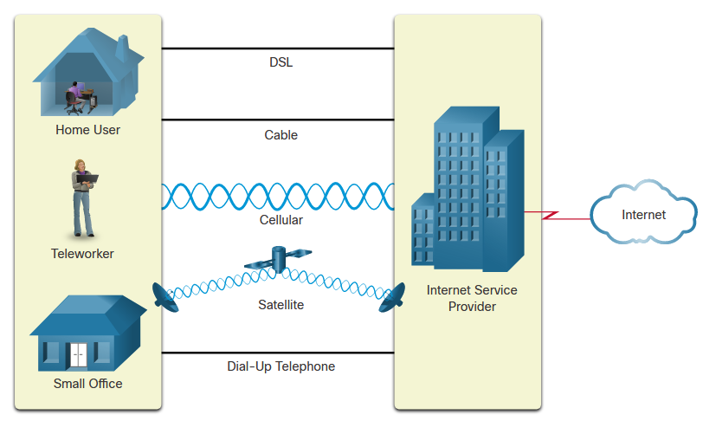
Internet Connections Home and Small Office Internet Connections
Connection | Description
Cable | high bandwidth, always on, internet offered by cable television service providers.
DSL | high bandwidth, always on, internet connection that runs over a telephone line.
Cellular | uses a cell phone network to connect to the internet.
Satellite | major benefit to rural areas without Internet Service Providers.
Dial-up telephone | an inexpensive, low bandwidth option using a modem.
Notes:
1 – Networking Today
1.5 – Internet Connections
1.5.2 – Home and Small Office Internet Connections

Slide 13
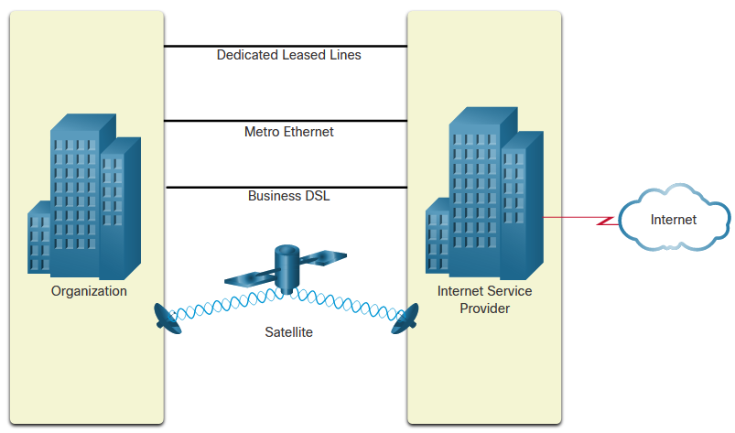
Internet Connections Businesses Internet Connections
Corporate business connections may require:
higher bandwidth
dedicated connections
managed services
Type of Connection | Description
Dedicated Leased Line | These are reserved circuits within the service provider’s network that connect distant offices with private voice and/or data networking.
Ethernet WAN | This extends LAN access technology into the WAN.
DSL | Business DSL is available in various formats including Symmetric Digital Subscriber Lines (SDSL).
Satellite | This can provide a connection when a wired solution is not available.
Notes:
1 – Networking Today
1.5 – Internet Connections
1.5.3 – Businesses Internet Connections

Slide 14
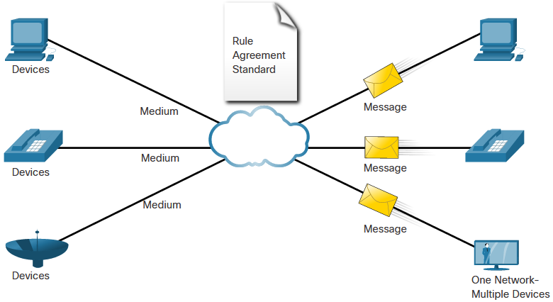
Internet Connections The Converging Network
Converged data networks carry multiple services on one link including:
data
voice
video
Converged networks can deliver data, voice, and video over the same network infrastructure. The network infrastructure uses the same set of rules and standards.
Notes:
1 – Networking Today
1.5 – Internet Connections
1.5.5 – The Converging Network (Cont.)

Slide 15
1.6 Reliable Networks
Notes:
1 – Networking Today
1.6 – Reliable Networks

Slide 16
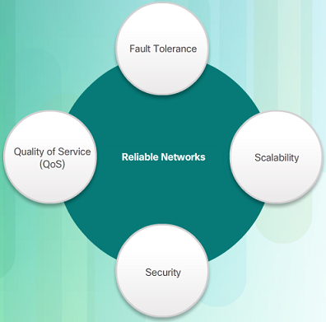
Reliable Network Network Architecture
Network Architecture refers to the technologies that support the infrastructure that moves data across the network.
There are four basic characteristics that the underlying architectures need to address to meet user expectations:
Fault Tolerance
Scalability
Quality of Service (QoS)
Security
Notes:
1 – Networking Today
1.6 – Reliable Networks
1.6.1 – Network Architecture

Slide 17
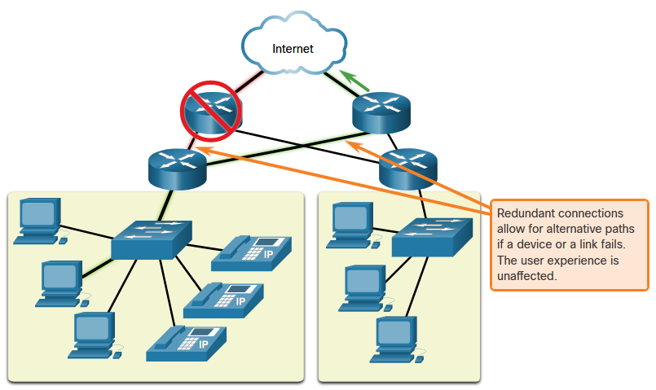
Reliable Network Fault Tolerance
A fault tolerant network limits the impact of a failure by limiting the number of affected devices. Multiple paths are required for fault tolerance.
Reliable networks provide redundancy by implementing a packet switched network:
Packet switching splits traffic into packets that are routed over a network.
Each packet could theoretically take a different path to the destination.
This is not possible with circuit-switched networks which establish dedicated circuits.
Notes:
1 – Networking Today
1.6 – Reliable Networks
1.6.2 – Fault Tolerance

Slide 18
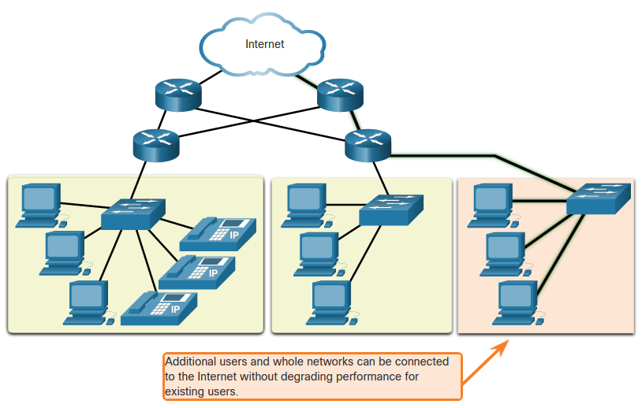
Reliable Network Scalability
A scalable network can expand quickly and easily to support new users and applications without impacting the performance of services to existing users.
Network designers follow accepted standards and protocols in order to make the networks scalable.
Notes:
1 – Networking Today
1.6 – Reliable Networks
1.6.3 – Scalability

Slide 19
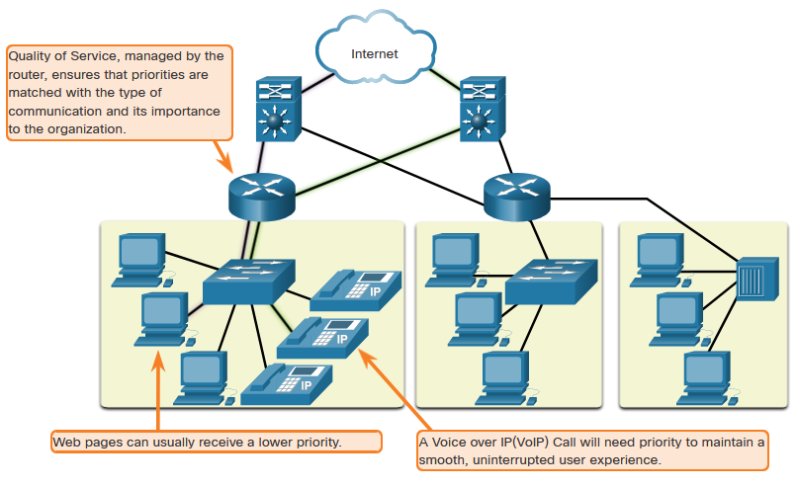
Reliable Network Quality of Service
Voice and live video transmissions require higher expectations for those services being delivered.
Have you ever watched a live video with constant breaks and pauses? This is caused when there is a higher demand for bandwidth than available – and QoS isn’t configured.
Quality of Service (QoS) is the primary mechanism used to ensure reliable delivery of content for all users.
With a QoS policy in place, the router can more easily manage the flow of data and voice traffic.
Notes:
1 – Networking Today
1.6 – Reliable Networks
1.6.4 – Quality of Service

Slide 20
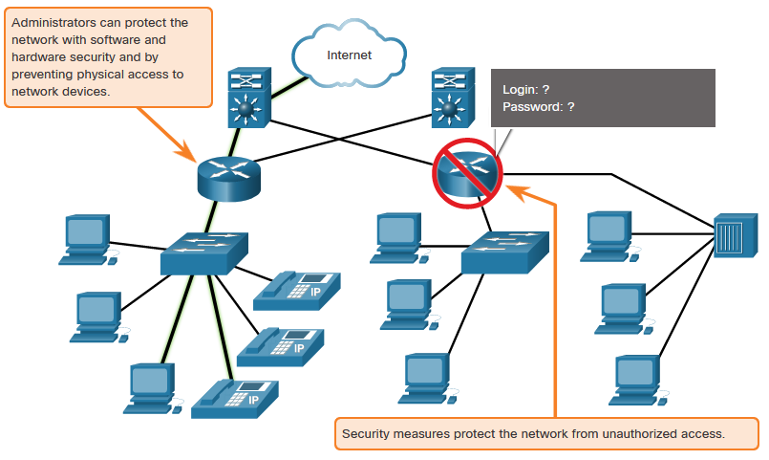
Reliable Network Network Security
There are two main types of network security that must be addressed:
Network infrastructure security
Physical security of network devices
Preventing unauthorized access to the devices
Information Security
Protection of the information or data transmitted over the network
Three goals of network security:
Confidentiality – only intended recipients can read the data
Integrity – assurance that the data has not be altered with during transmission
Availability – assurance of timely and reliable access to data for authorized users
Notes:
1 – Networking Today
1.6 – Reliable Networks
1.6.5 – Network Security
1.6.6 – Check Your Understanding – Reliable Networks

Slide 21
1.7 Network Trends
Notes:
1 – Networking Today
1.7 – Network Trends

Slide 22

Network Trends Recent Trends
The role of the network must adjust and continually transform in order to be able to keep up with new technologies and end user devices as they constantly come to the market.
Several new networking trends that effect organizations and consumers:
Bring Your Own Device (BYOD)
Online collaboration
Video communications
Cloud computing
IoT
Notes:
1 – Networking Today
1.7 – Network Trends
1.7.1 – Recent Trends

Slide 23
Network Trends Cloud Computing
Four types of Clouds:
Public Clouds
Available to the general public through a pay-per-use model or for free.
Private Clouds
Intended for a specific organization or entity such as the government.
Hybrid Clouds
Made up of two or more Cloud types – for example, part custom and part public.
Each part remains a distinctive object but both are connected using the same architecture.
Custom Clouds
Built to meet the needs of a specific industry, such as healthcare or media.
Can be private or public.
Notes:
1 – Networking Today
1.7 – Network Trends
1.7.6 – Cloud Computing (Cont.)

Slide 24
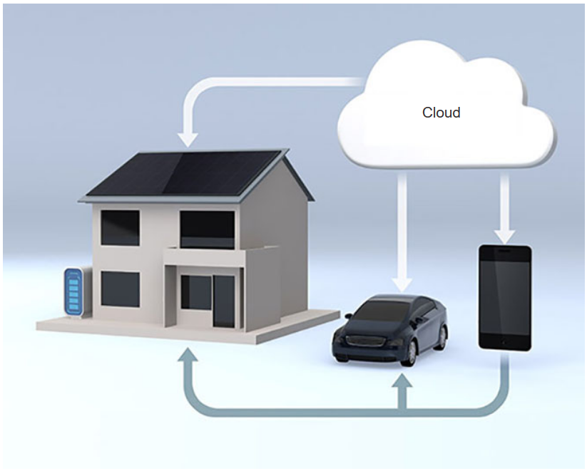
Network Trends Technology Trends in the Home
Smart home technology is a growing trend that allows technology to be integrated into every-day appliances which allows them to interconnect with other devices.
Ovens might know what time to cook a meal for you by communicating with your calendar on what time you are scheduled to be home.
Smart home technology is currently being developed for all rooms within a house.
Notes:
1 – Networking Today
1.7 – Network Trends
1.7.7 – Technology Trends in the Home

Slide 25
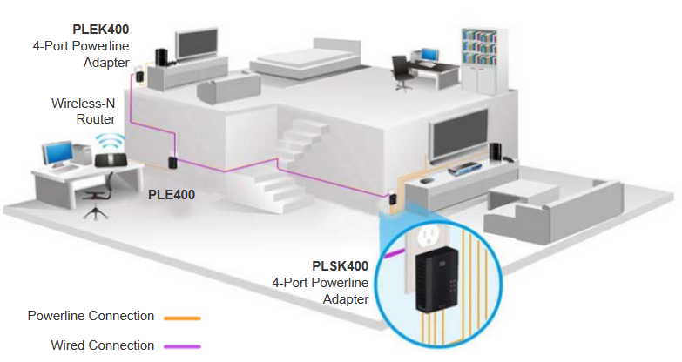
Network Trends Powerline Networking
Powerline networking can allow devices to connect to a LAN where data network cables or wireless communications are not a viable option.
Using a standard powerline adapter, devices can connect to the LAN wherever there is an electrical outlet by sending data on certain frequencies.
Powerline networking is especially useful when wireless access points cannot reach all the devices in the home.
Notes:
1 – Networking Today
1.7 – Network Trends
1.7.8 – Powerline Networking

Slide 26
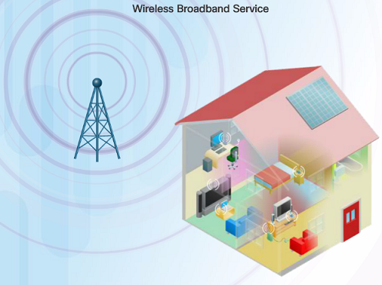
Network Trends Wireless Broadband
In addition to DSL and cable, wireless is another option used to connect homes and small businesses to the internet.
More commonly found in rural environments, a Wireless Internet Service Provider (WISP) is an ISP that connects subscribers to designated access points or hotspots.
Wireless broadband is another solution for the home and small businesses.
Uses the same cellular technology used by a smart phone.
An antenna is installed outside the house providing wireless or wired connectivity for devices in the home.
Notes:
1 – Networking Today
1.7 – Network Trends
1.7.9 – Wireless Broadband
1.7.10 – Check Your Understanding – Network Trends

Slide 27
1.8 Network Security
Notes:
1 – Networking Today
1.8 – Network Security

Slide 28
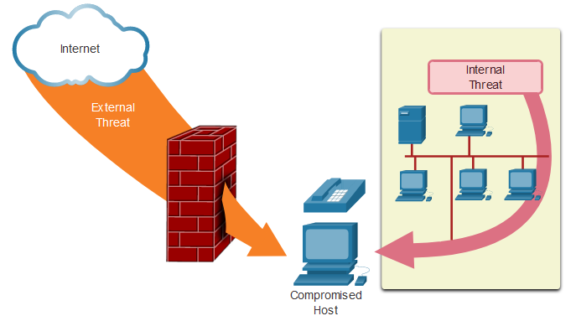
Network Security Security Threats (Cont.)
External Threats:
Viruses, worms, and Trojan horses
Spyware and adware
Zero-day attacks
Threat Actor attacks
Denial of service attacks
Data interception and theft
Identity theft
Internal Threats:
lost or stolen devices
accidental misuse by employees
malicious employees
Notes:
1 – Networking Today
1.8 – Network Security
1.8.1 – Security Threats (Cont.)

Slide 29
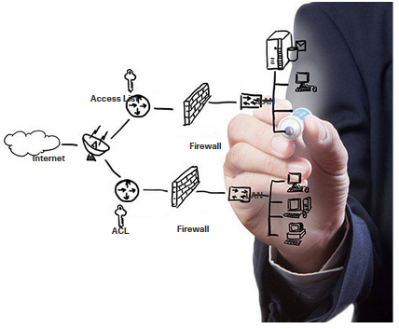
Network Security Security Solutions
Security must be implemented in multiple layers using more than one security solution.
Network security components for home or small office network:
Antivirus and antispyware software should be installed on end devices.
Firewall filtering used to block unauthorized access to the network.
Notes:
1 – Networking Today
1.8 – Network Security
1.8.2 – Security Solutions

Slide 30
Network Security Security Solutions (Cont.)
Larger networks have additional security requirements:
Dedicated firewall system
Access control lists (ACL)
Intrusion prevention systems (IPS)
Virtual private networks (VPN)
The study of network security starts with a clear understanding of the underlying switching and routing infrastructure.
Notes:
1 – Networking Today
1.8 – Network Security
1.8.2 – Security Solutions (Cont.)
1.8.3 – Check Your Understanding – Network Security

Slide 31
Module 2: Basic Switch and End Device Configuration
Introductions to Networks v7.0 (ITN)
Notes:
Cisco Networking Academy Program
Introduction to Networks v7.0
Module 2: Basic Switch and End Device Configuration

Slide 32
2.1 Cisco IOS Access
Notes:
2 – Basic Switch and End Device Configuration
2.1 – Cisco IOS Access

Slide 33
Cisco IOS Access Operating Systems
Shell - The user interface that allows users to request specific tasks from the computer. These requests can be made either through the CLI or GUI interfaces.
Kernel - Communicates between the hardware and software of a computer and manages how hardware resources are used to meet software requirements.
Hardware - The physical part of a computer including underlying electronics.
Notes:
2 – Basic Switch and End Device Configuration
2.1 – Cisco IOS Access
2.1.1 – Operating Systems

Slide 34
Cisco IOS Access GUI
A GUI allows the user to interact with the system using an environment of graphical icons, menus, and windows.
A GUI is more user-friendly and requires less knowledge of the underlying command structure that controls the system.
Examples of these are: Windows, macOS, Linux KDE, Apple iOS and Android.
GUIs can fail, crash, or simply not operate as specified. For these reasons, network devices are typically accessed through a CLI.
Notes:
2 – Basic Switch and End Device Configuration
2.1 – Cisco IOS Access
2.1.2 – GUI

Slide 35
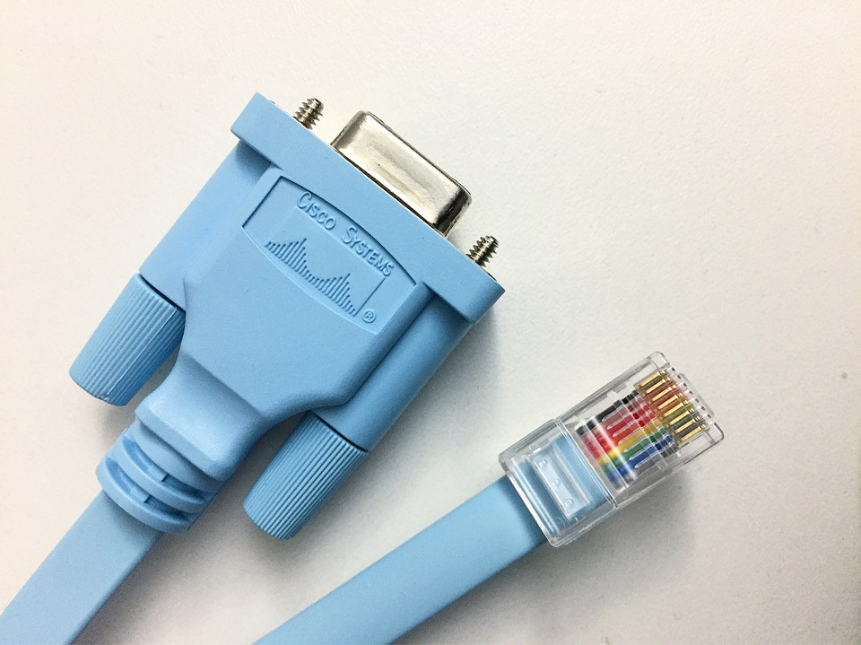
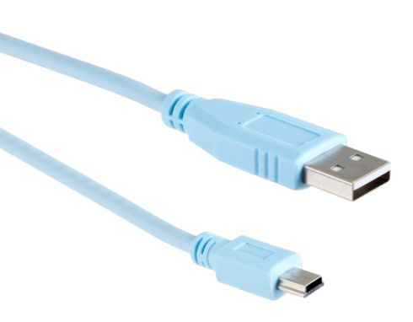
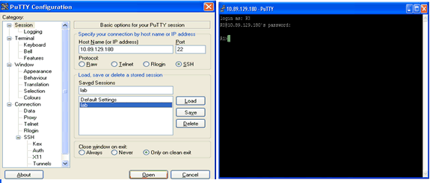
Cisco IOS Access Access Methods
Console – A physical management port used to access a device in order to provide maintenance, such as performing the initial configurations.
Secure Shell (SSH) – Establishes a secure remote CLI connection to a device, through a virtual interface, over a network. (Note: This is the recommended method for remotely connecting to a device.)
Telnet – Establishes an insecure remote CLI connection to a device over the network. (Note: User authentication, passwords and commands are sent over the network in plaintext.)
Notes:
2 – Basic Switch and End Device Configuration
2.1 – Cisco IOS Access
2.1.4 – Access Methods

Slide 36
2.2 IOS Navigation
Notes:
2 – Basic Switch and End Device Configuration
2.2 – IOS Navigation

Slide 37
IOS Navigation Primary Command Modes
User EXEC Mode:
Allows access to only a limited number of basic monitoring commands
Identified by the CLI prompt that ends with the > symbol
Privileged EXEC Mode:
Allows access to all commands and features
Identified by the CLI prompt that ends with the # symbol
Notes:
2 – Basic Switch and End Device Configuration
2.2 – IOS Navigation
2.2.1 – Primary Command Modes

Slide 38
IOS Navigation Configuration Mode and Subconfiguration Modes
Global Configuration Mode:
Used to access configuration options on the device
Line Configuration Mode:
Used to configure console, SSH, Telnet or AUX access
Interface Configuration Mode:
Used to configure a switch port or router interface
Notes:
2 – Basic Switch and End Device Configuration
2.2 – IOS Navigation
2.2.2 – Configuration Mode and Subconfiguration Modes

Slide 39
IOS Navigation Navigation Between IOS Modes
Privileged EXEC Mode:
To move from user EXEC mode to privilege EXEC mode, use the enabled command.
Global Configuration Mode:
To move in and out of global configuration mode, use the configure terminal command. To return to privilege EXEC mode, use the exit command.
Line Configuration Mode:
To move in and out of line configuration mode, use the line command followed by the management line type. To return to global configuration mode, use the exit command.
Notes:
2 – Basic Switch and End Device Configuration
2.2 – IOS Navigation
2.2.4 – Navigate Between IOS Modes

Slide 40
IOS Navigation Navigation Between IOS Modes (Cont.)
Subconfiguration Modes:
To move out of any subconfiguration mode to get back to global configuration mode, use the exit command. To return to privilege EXEC mode, use the end command or key combination Ctrl +Z.
To move directly from one subconfiguration mode to another, type in the desired subconfiguration mode command. In the example, the command prompt changes from (config-line)# to (config-if)#.
Notes:
2 – Basic Switch and End Device Configuration
2.2 – IOS Navigation
2.2.4 – Navigate Between IOS Modes

Slide 41
2.3 The Command Structure
Notes:
2 – Basic Switch and End Device Configuration
2.3 – The Command Structure

Slide 42
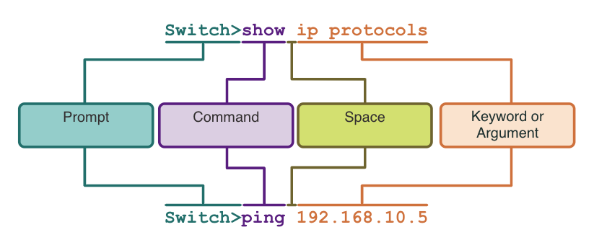
The Command Structure Basic IOS Command Structure
Keyword – This is a specific parameter defined in the operating system (in the figure, ip protocols).
Argument - This is not predefined; it is a value or variable defined by the user (in the figure, 192.168.10.5).
Notes:
2 – Basic Switch and End Device Configuration
2.3 – The Command Structure
2.3.1 – Basic IOS Command Structure

Slide 43
The Command Structure IOS Help Features
The IOS has two forms of help available: context-sensitive help and command syntax check.
Context-sensitive help enables you to quickly find answers to these questions:
Which commands are available in each command mode?
Which commands start with specific characters or group of characters?
Which arguments and keywords are available to particular commands?
Command syntax check verifies that a valid command was entered by the user.
If the interpreter cannot understand the command being entered, it will provide feedback describing what is wrong with the command.
Notes:
2 – Basic Switch and End Device Configuration
2.3 – The Command Structure
2.3.3 – IOS Help Features

Slide 44
The Command Structure Hot Keys and Shortcuts
The IOS CLI provides hot keys and shortcuts that make configuring, monitoring, and troubleshooting easier.
Commands and keywords can be shortened to the minimum number of characters that identify a unique selection. For example, the configure command can be shortened to conf because configure is the only command that begins with conf.
Notes:
2 – Basic Switch and End Device Configuration
2.3 – The Command Structure
2.3.5 – Hot Keys and Shortcuts

Slide 45
The Command Structure Hot Keys and Shortcuts (Cont.)
The table below is a brief list of keystrokes to enhance command line editing.
Keystroke | Description
Tab | Completes a partial command name entry.
Backspace | Erases the character to the left of the cursor.
Left Arrow or Ctrl+B | Moves the cursor one character to the left.
Right Arrow or Ctrl+F | Moves the cursor one character to the right.
Up Arrow or Ctrl+P | Recalls the commands in the history buffer, beginning with the most recent commands.
Notes:
2 – Basic Switch and End Device Configuration
2.3 – The Command Structure
2.3.5 – Hot Keys and Shortcuts

Slide 46
The Command Structure Hot Keys and Shortcuts (Cont.)
When a command output produces more text than can be displayed in a terminal window, the IOS will display a “--More--” prompt. The table below describes the keystrokes that can be used when this prompt is displayed.
The table below lists commands that can be used to exit out of an operation.
Keystroke | Description
Enter Key | Displays the next line.
Space Bar | Displays the next screen.
Any other key | Ends the display string, returning to privileged EXEC mode.
Keystroke | Description
Ctrl-C | When in any configuration mode, ends the configuration mode and returns to privileged EXEC mode.
Ctrl-Z | When in any configuration mode, ends the configuration mode and returns to privileged EXEC mode.
Ctrl-Shift-6 | All-purpose break sequence used to abort DNS lookups, traceroutes, pings, etc.
Note: To see more hot keys and shortcuts refer to 2.3.5.
Notes:
2 – Basic Switch and End Device Configuration
2.3 – The Command Structure
2.3.5 – Hot Keys and Shortcuts

Slide 47
2.4 Basic Device Configuration
Notes:
2 – Basic Switch and End Device Configuration
2.4 – Basic Device Configuration

Slide 48
Basic Device Configuration Device Names
The first configuration command on any device should be to give it a unique hostname.
By default, all devices are assigned a factory default name. For example, a Cisco IOS switch is "Switch.”
Guideline for naming devices:
Start with a letter
Contain no spaces
End with a letter or digit
Use only letters, digits, and dashes
Be less than 64 characters in length
Note: To return the switch to the default prompt, use the no hostname global config command.
Notes:
2 – Basic Switch and End Device Configuration
2.4 – Basic Device Configuration
2.4.1 – Device Names

Slide 49

Basic Device Configuration Password Guidelines
The use of weak or easily guessed passwords are a security concern.
All networking devices should limit administrative access by securing privileged EXEC, user EXEC, and remote Telnet access with passwords. In addition, all passwords should be encrypted and legal notifications provided.
Password Guidelines:
Use passwords that are more than eight characters in length.
Use a combination of upper and lowercase letters, numbers, special characters, and/or numeric sequences.
Avoid using the same password for all devices.
Do not use common words because they are easily guessed.
Note: Most of the labs in this course use simple passwords such as cisco or class. These passwords are considered weak and easily guessable and should be avoided in production environments.
Notes:
2 – Basic Switch and End Device Configuration
2.4 – Basic Device Configuration
2.4.2 – Password Guidelines

Slide 50
Basic Device Configuration Configure Passwords
Securing user EXEC mode access:
First enter line console configuration mode using the line console 0 command in global configuration mode.
Next, specify the user EXEC mode password using the password password command.
Finally, enable user EXEC access using the login command.
Securing privileged EXEC mode access:
First enter global configuration mode.
Next, use the enable secret password command.
Notes:
2 – Basic Switch and End Device Configuration
2.4 – Basic Device Configuration
2.4.3 – Configure Passwords

Slide 51
Basic Device Configuration Configure Passwords (Cont.)
Securing VTY line access:
First enter line VTY configuration mode using the line vty 0 15 command in global configuration mode.
Next, specify the VTY password using the password password command.
Finally, enable VTY access using the login command.
Note: VTY lines enable remote access using Telnet or SSH to the device. Many Cisco switches support up to 16 VTY lines that are numbered 0 to 15.
Notes:
2 – Basic Switch and End Device Configuration
2.4 – Basic Device Configuration
2.4.3 – Configure Passwords

Slide 52
Basic Device Configuration Encrypt Passwords
The startup-config and running-config files display most passwords in plaintext.
To encrypt all plaintext passwords, use the service password-encryption global config command.
Use the show running-config command to verify that the passwords on the device are now encrypted.
Notes:
2 – Basic Switch and End Device Configuration
2.4 – Basic Device Configuration
2.4.4 – Encrypt Passwords

Slide 53
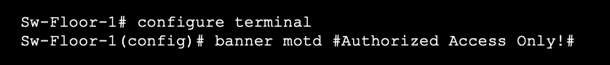
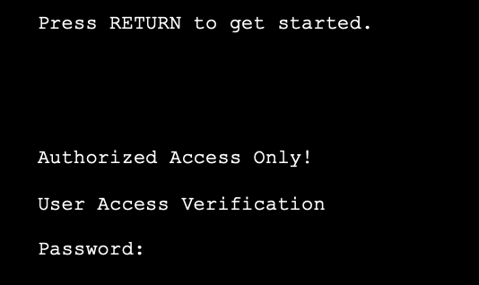
Basic Device Configuration Banner Messages
A banner message is important to warn unauthorized personnel from attempting to access the device.
To create a banner message of the day on a network device, use the banner motd # the message of the day # global config command.
The banner will be displayed on attempts to access the device.
Note: The “#” in the command syntax is called the delimiting character. It is entered before and after the message.
Notes:
2 – Basic Switch and End Device Configuration
2.4 – Basic Device Configuration
2.4.5 – Banner Messages

Slide 54
2.5 Save Configurations
Notes:
2 – Basic Switch and End Device Configuration
2.5 – Save Configurations

Slide 55
Save Configurations Configuration Files
There are two system files that store the device configuration:
startup-config - This is the saved configuration file that is stored in NVRAM. It contains all the commands that will be used by the device upon startup or reboot. Flash does not lose its contents when the device is powered off.
running-config - This is stored in Random Access Memory (RAM). It reflects the current configuration. Modifying a running configuration affects the operation of a Cisco device immediately. RAM is volatile memory. It loses all of its content when the device is powered off or restarted.
To save changes made to the running configuration to the startup configuration file, use the copy running-config startup-config privileged EXEC mode command.
Notes:
2 – Basic Switch and End Device Configuration
2.5 – Save Configurations
2.5.1 – Configuration Files

Slide 56
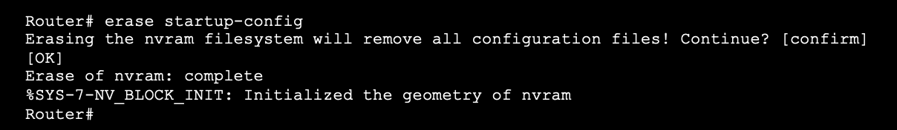
Save Configurations Alter the Running Configurations
If changes made to the running config do not have the desired effect and the running-config has not yet been saved, you can restore the device to its previous configuration. To do this you can:
Remove the changed commands individually.
Reload the device using the reload command in privilege EXEC mode. Note: This will cause the device to briefly go offline, leading to network downtime.
If the undesired changes were saved to the startup-config, it may be necessary to clear all the configurations using the erase startup-config command in privilege EXEC mode.
After erasing the startup-config, reload the device to clear the running-config file from RAM.
Notes:
2 – Basic Switch and End Device Configuration
2.5 – Save Configurations
2.5.2 – Alter the Running Configuration

Slide 57
2.6 Ports and Addresses
Notes:
2 – Basic Switch and End Device Configuration
2.6 – Ports and Addresses

Slide 58
Ports and Addresses IP Addresses
The use of IP addresses is the primary means of enabling devices to locate one another and establish end-to-end communication on the internet.
The structure of an IPv4 address is called dotted decimal notation and is represented by four decimal numbers between 0 and 255.
An IPv4 subnet mask is a 32-bit value that differentiates the network portion of the address from the host portion. Coupled with the IPv4 address, the subnet mask determines to which subnet the device is a member.
The default gateway address is the IP address of the router that the host will use to access remote networks, including the internet.
Notes:
2 – Basic Switch and End Device Configuration
2.6 – Ports and Addresses
2.6.1 – IP Addresses

Slide 59
Ports and Addresses IP Addresses (Cont.)
IPv6 addresses are 128 bits in length and written as a string of hexadecimal values. Every four bits is represented by a single hexadecimal digit; for a total of 32 hexadecimal values. Groups of four hexadecimal digits are separated by a colon “:”.
IPv6 addresses are not case-sensitive and can be written in either lowercase or uppercase.
Note: IP in this course refers to both the IPv4 and IPv6 protocols. IPv6 is the most recent version of IP and is replacing the more common IPv4.
Notes:
2 – Basic Switch and End Device Configuration
2.6 – Ports and Addresses
2.6.1 – IP Addresses

Slide 60
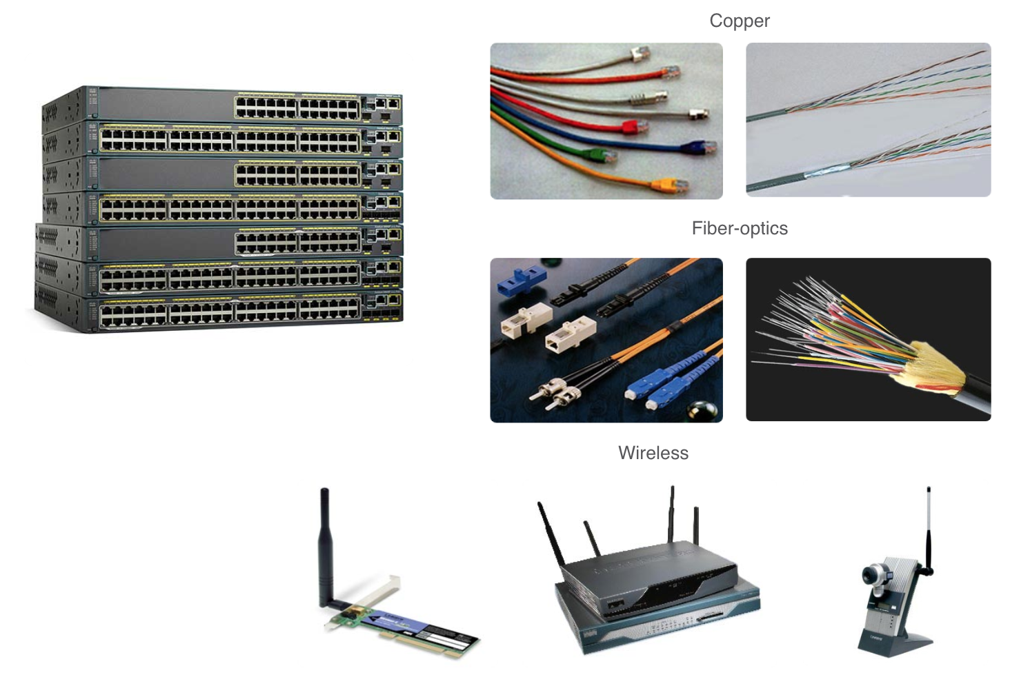
Ports and Addresses Interfaces and Ports
Network communications depend on end user device interfaces, networking device interfaces, and the cables that connect them.
Types of network media include twisted-pair copper cables, fiber-optic cables, coaxial cables, or wireless.
Different types of network media have different features and benefits. Some of the differences between various types of media include:
Distance the media can successfully carry a signal
Environment in which the media is to be installed
Amount of data and the speed at which it must be transmitted
Cost of the media and installation
Notes:
2 – Basic Switch and End Device Configuration
2.6 – Ports and Addresses
2.6.2 – Interfaces and Ports
2.6.3 – Check Your Understanding - Ports and Addresses

Slide 61
2.7 Configure IP Addressing
Notes:
2 – Basic Switch and End Device Configuration
2.7 – Configure IP Addressing

Slide 62
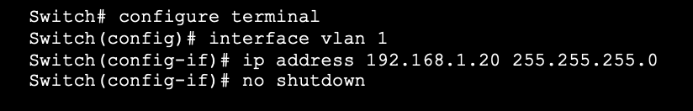
Configure IP Addressing Switch Virtual Interface Configuration
To access the switch remotely, an IP address and a subnet mask must be configured on the SVI.
To configure an SVI on a switch:
Enter the interface vlan 1 command in global configuration mode.
Next assign an IPv4 address using the ip address ip-address subnet-mask command.
Finally, enable the virtual interface using the no shutdown command.
Notes:
2 – Basic Switch and End Device Configuration
2.7 – Configure IP Addressing
2.7.4 – Switch Virtual Interface Configuration
2.7.5 – Syntax Checker – Configure a Switch Virtual interface

